Slide 1
SUPER-X – DATA WAREHOUSING
Group 6: Procurement
14th February 2018

Slide 2
CONTENT
REQUIREMENT ANALYSIS
ANALYSIS OF DATA SOURCES
CONCEPTUAL DESIGN
PROOF-OF-CONCEPT
PROCESS INTELLIGENCE
BUSINESS RECOMMENDATIONS

Slide 3
CONTENT
REQUIREMENT ANALYSIS
ANALYSIS OF DATA SOURCES
CONCEPTUAL DESIGN
PROOF-OF-CONCEPT
PROCESS INTELLIGENCE
BUSINESS RECOMMENDATIONS

Slide 4
REQUIREMENT ANALYSIS
Identify relevant tables
Identification of relevant tables for procurement
Exclude irrelevant tables
Exclude tables from Production and Sales and only select Procurement
Create OLTP
Create OLTP as a basis for further data profiling
Notes:
Identification of relevant tables for procurement
Exclude tables from Production and Sales and only select Procurement
Create OLTP as a basis for further data profiling

Slide 5
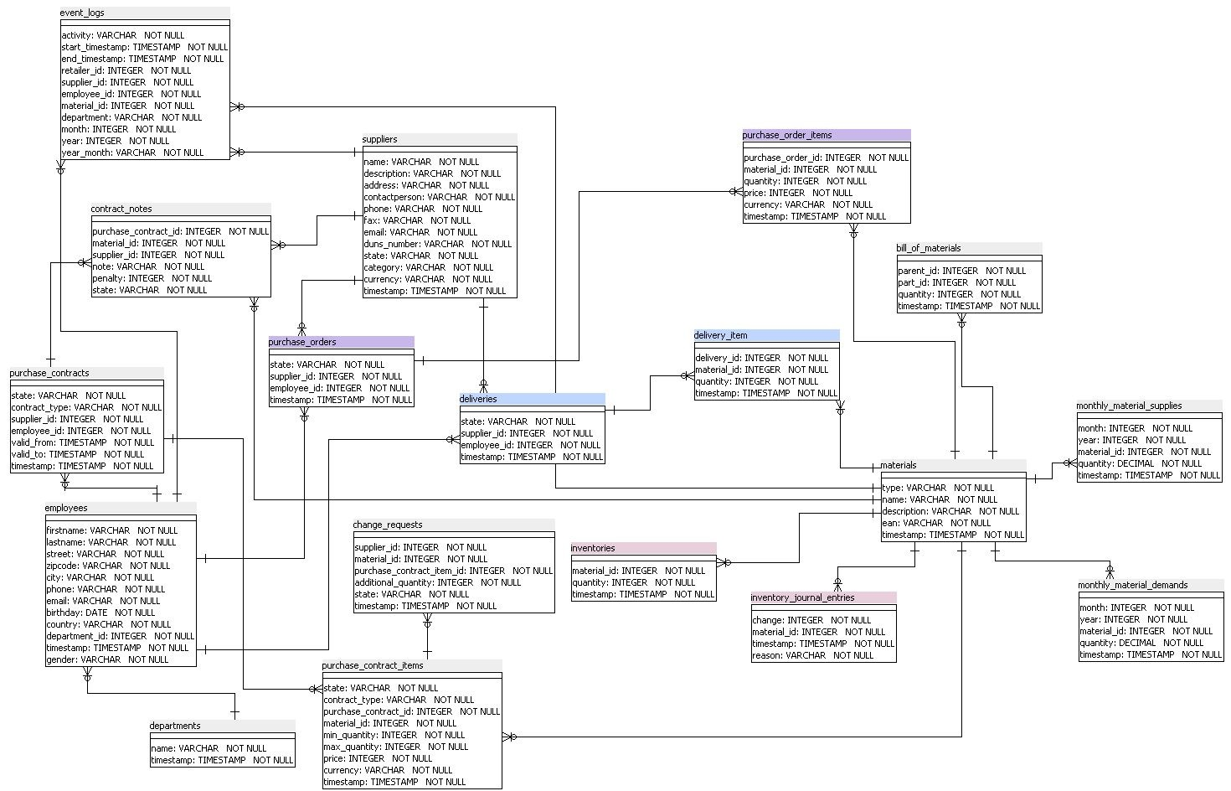
OLTP SCHEMA

Slide 6
KPIs
Questions | Business Requirement | Importance | HIgh level Entities | Measures
Q1 | What is the average quantity bought for each material and material type per month and year? | Medium | Material, Material Type, Month, Year | Quantity bought
Q2 | What is the total quantity bought for each material and material type per month and year? | High | Material, Material Type, Month, Year | Quantity bought
Q3 | What is the highest and lowest price per material per month and year? | Medium | Material, Month, Year | Price
Q4 | What is the total order value per month and year? | High | Month, Year | Price * Quantity
Q5 | What is the total order value per supplier and supplier category per month and year | High | Supplier, Supplier Category, Month, Year | Price * Quantity
Q6 | What is the total quantity ordered per country? | Low | Country | Quantity
Q7 | What is the order volume per supplier and supplier category per month and year? | High | Supplier, Supplier Category, Month, Year | Quantity
Q8 | What is the number of suppliers per material and supplier category per month and year? | HIgh | Supplier, Supplier Category, Material, Month, Year
Q9 | What is the order volume per supplier and country per month and year? | Medium | Supplier, Supplier Category, Country, Month, Year | Quantity
Q10 | What is the order value per supplier and country per month and year? | Medium | Supplier, Supplier Category, Country, Month, Year | Price * Quantity
Notes:
Identification of relevant tables for procurement
Exclude tables from Production and Sales and only select Procurement
Create OLTP as a basis for further data profiling

Slide 7
CONTENT
REQUIREMENT ANALYSIS
ANALYSIS OF DATA SOURCES
CONCEPTUAL DESIGN
PROOF-OF-CONCEPT
PROCESS INTELLIGENCE
BUSINESS RECOMMENDATIONS

Slide 8

DATA PROFILING
Types of data profiles used:
Candidate Key Profiles
Column Length Distribution Profiles
Column Null Ratio Profiles
Column Pattern Profiles
Column Statistics Profiles
Column Value Distribution Profiles
Functional Dependency Profiles
Notes:
Deleted „AS-IS-Analysis results:“ as a subline because it actually is a duplicate of the headline

Slide 9

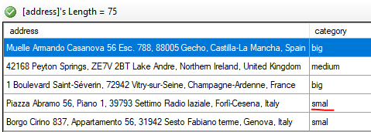
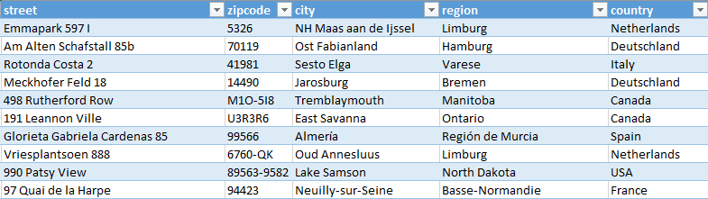

DATA CLEANSING: PROBLEM
Example: Supplier table
Combined field for the whole address:
Category “smal”:
Notes:
Deleted „AS-IS-Analysis results:“ as a subline because it actually is a duplicate of the headline

Slide 10
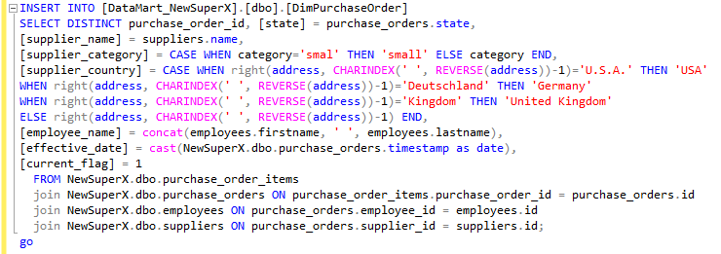
DATA CLEANSING: SOLUTION
Notes:
Deleted „AS-IS-Analysis results:“ as a subline because it actually is a duplicate of the headline

Slide 11
CONTENT
REQUIREMENT ANALYSIS
ANALYSIS OF DATA SOURCES
CONCEPTUAL DESIGN
PROOF-OF-CONCEPT
PROCESS INTELLIGENCE
BUSINESS RECOMMENDATIONS

Slide 12
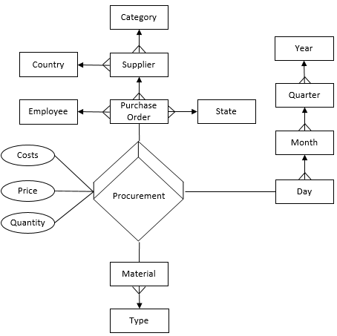
CONCEPTUAL DESIGN
MER diagram:
Notes:
Deleted „AS-IS-Analysis results:“ as a subline because it actually is a duplicate of the headline

Slide 13
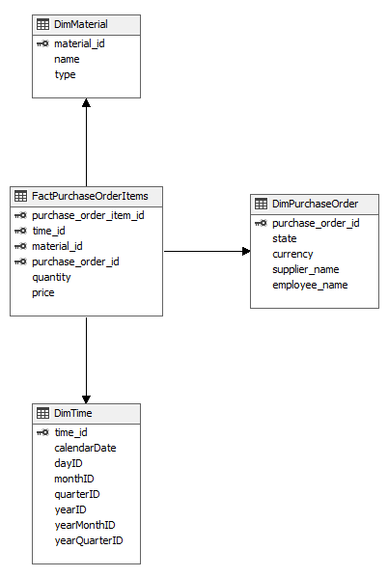
LOGICAL DESIGN
STAR schema:
Notes:
Deleted „AS-IS-Analysis results:“ as a subline because it actually is a duplicate of the headline

Slide 14
CONTENT
REQUIREMENT ANALYSIS
ANALYSIS OF DATA SOURCES
CONCEPTUAL DESIGN
PROOF-OF-CONCEPT
PROCESS INTELLIGENCE
BUSINESS RECOMMENDATIONS

Slide 15
ETL PROCESS
EXTRACT
TRANSFORM
Join relevant tables
LOAD
Load transformed data into database
Change column labels
Exclude unnecessary data
Extract data from Super X OLTP system
Convert currencies in EUR
Notes:
Deleted „Desired outcome:“as a subline because it actually is a duplicate of the headline
Implement Web-Services (with automatic email notifications about changes)
Eliminate non-value-adding processes
Parallelize tasks in procurement
Increase production cycles (3 per month)
Increase stock in production
Stronger Customer-Orientation
- VA vs. BVA

Slide 16
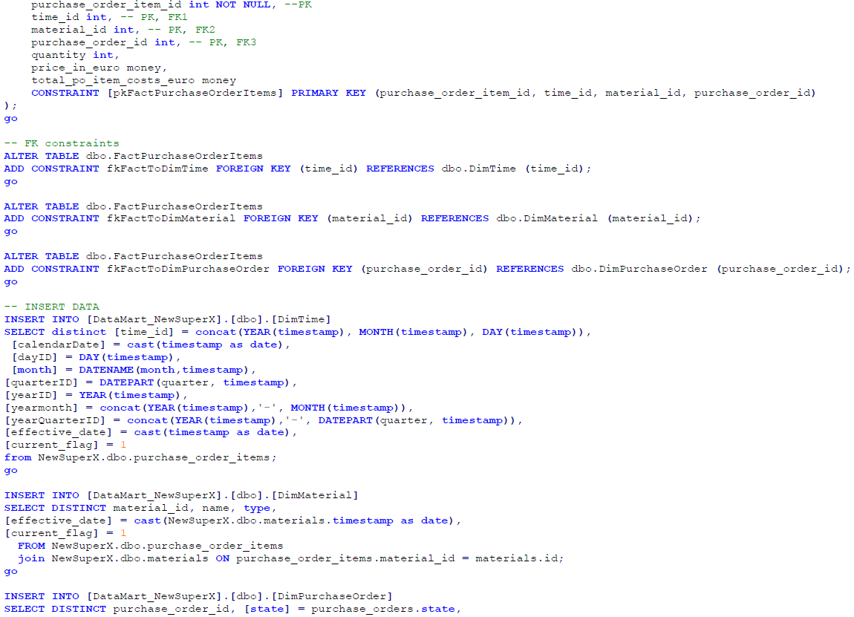
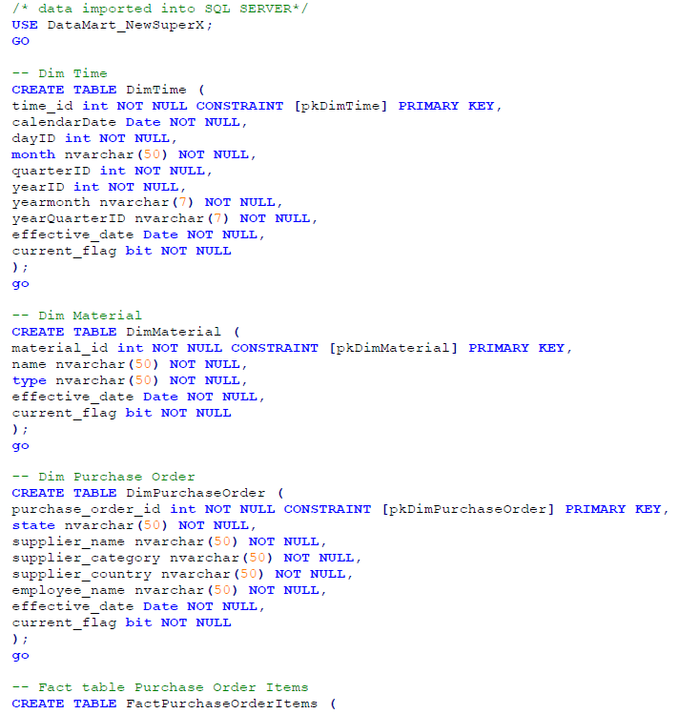
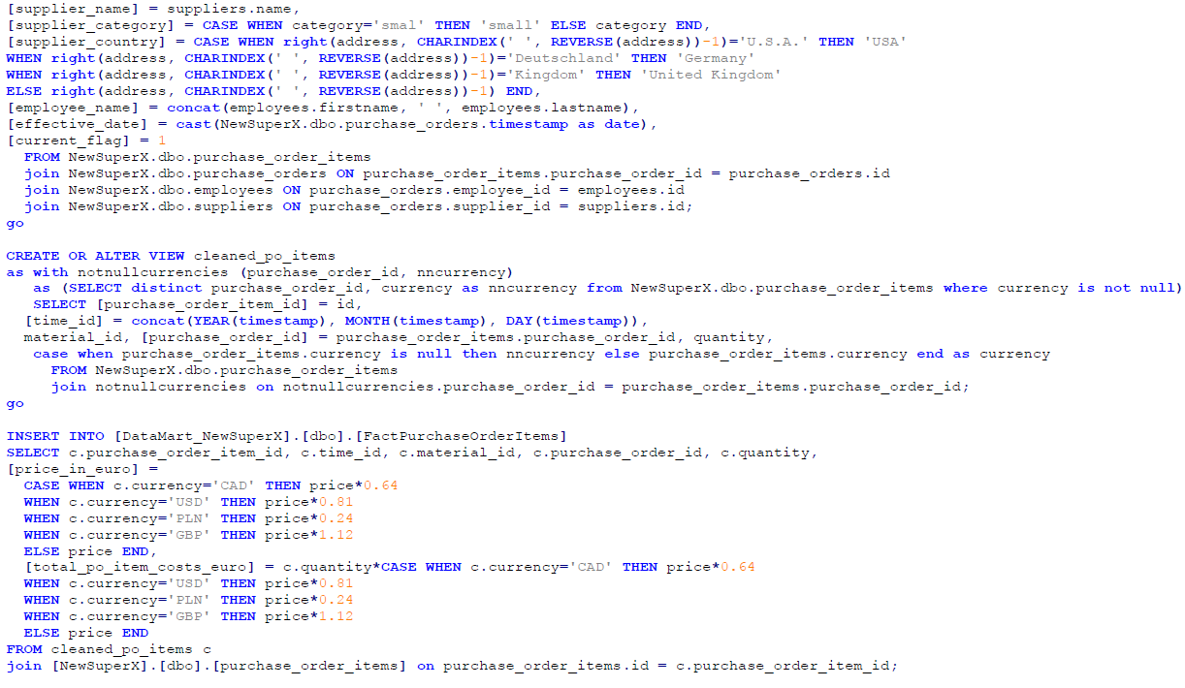
ETL PROCESS
Notes:
Deleted „AS-IS-Analysis results:“ as a subline because it actually is a duplicate of the headline

Slide 17
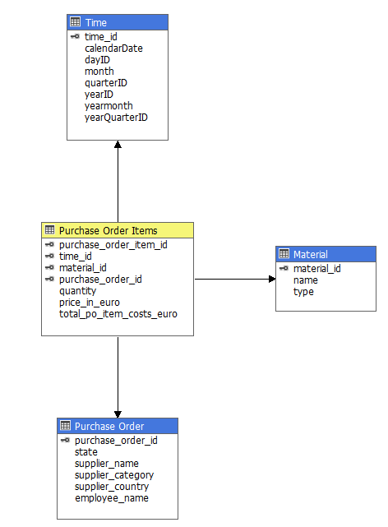
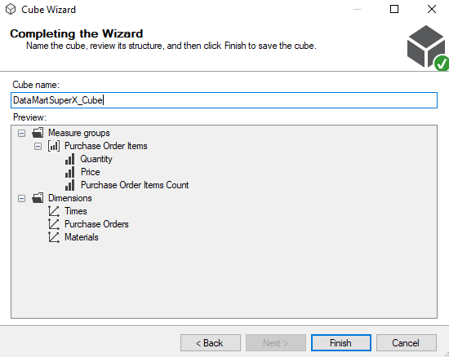
IMPLEMENTED CUBE
Notes:
Deleted „AS-IS-Analysis results:“ as a subline because it actually is a duplicate of the headline

Slide 18

VISUALIZATION
Advantages:
+ Userfriendly Interface
+ Vivid visualizations
+ In-Memory Architecture
+ Quick Insights
Notes:
Deleted „AS-IS-Analysis results:“ as a subline because it actually is a duplicate of the headline

Slide 19
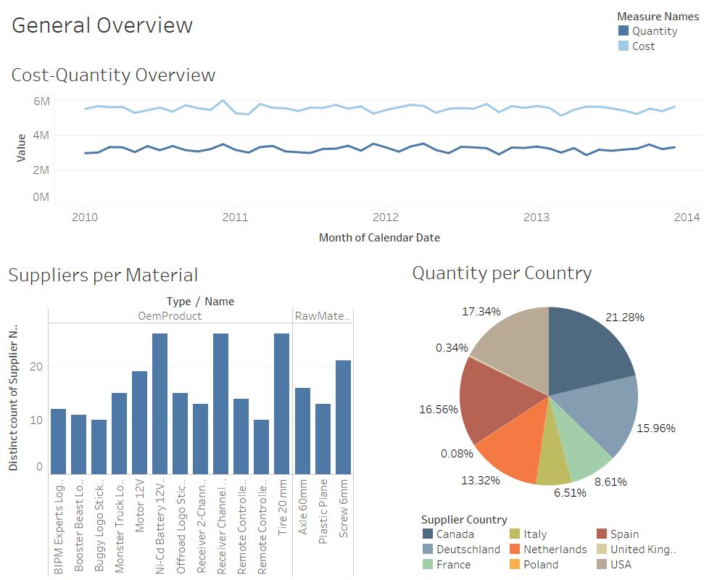
Notes:
Deleted „AS-IS-Analysis results:“ as a subline because it actually is a duplicate of the headline

Slide 20

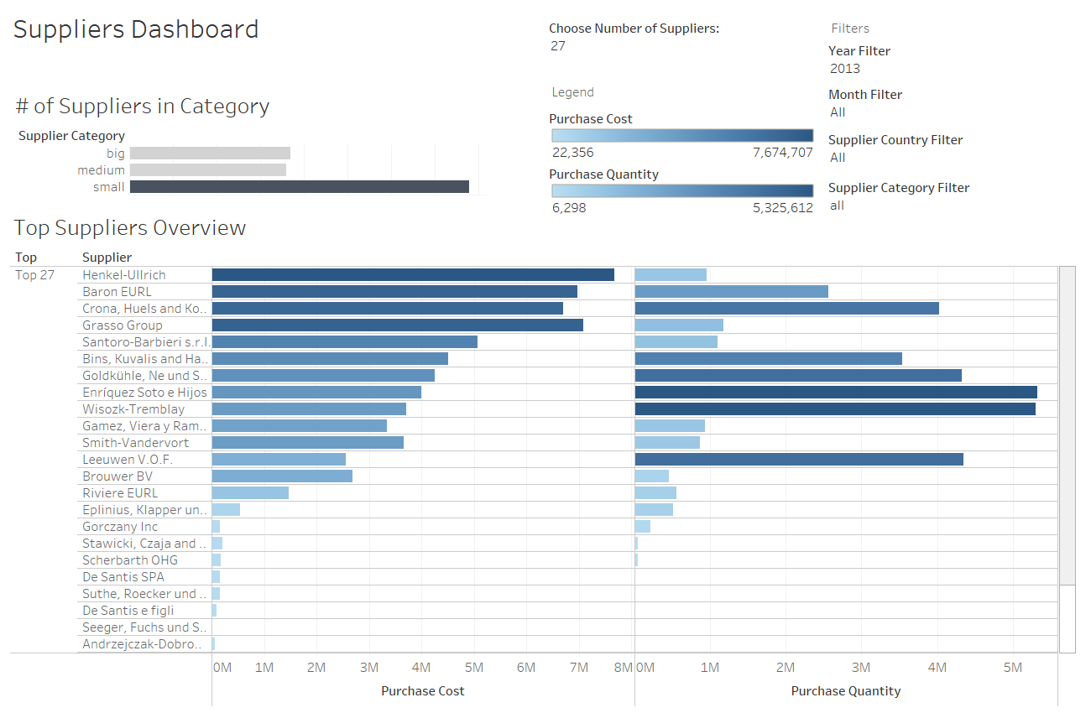
Notes:
Deleted „AS-IS-Analysis results:“ as a subline because it actually is a duplicate of the headline

Slide 21
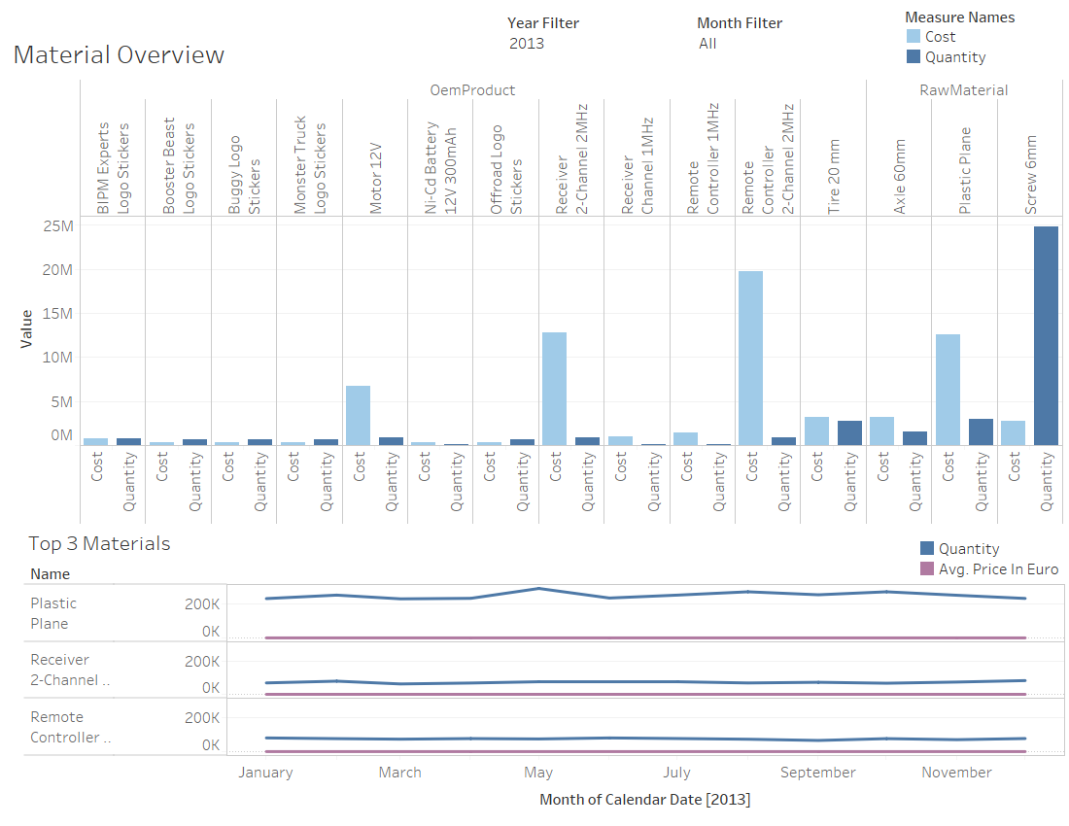
Notes:
Deleted „AS-IS-Analysis results:“ as a subline because it actually is a duplicate of the headline

Slide 22
CONTENT
REQUIREMENT ANALYSIS
ANALYSIS OF DATA SOURCES
CONCEPTUAL DESIGN
PROOF-OF-CONCEPT
PROCESS INTELLIGENCE
BUSINESS RECOMMENDATIONS

Slide 23
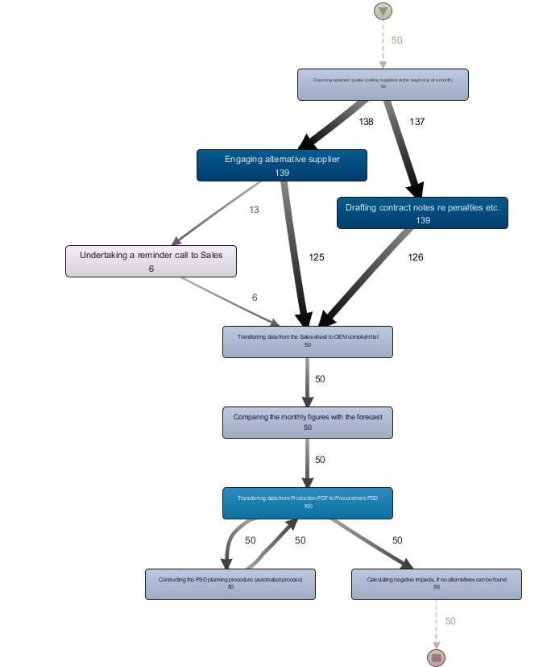
Frequency of tasks over the whole period (2010-2014):
Findings:
Inefficiency
Repetition

Slide 24
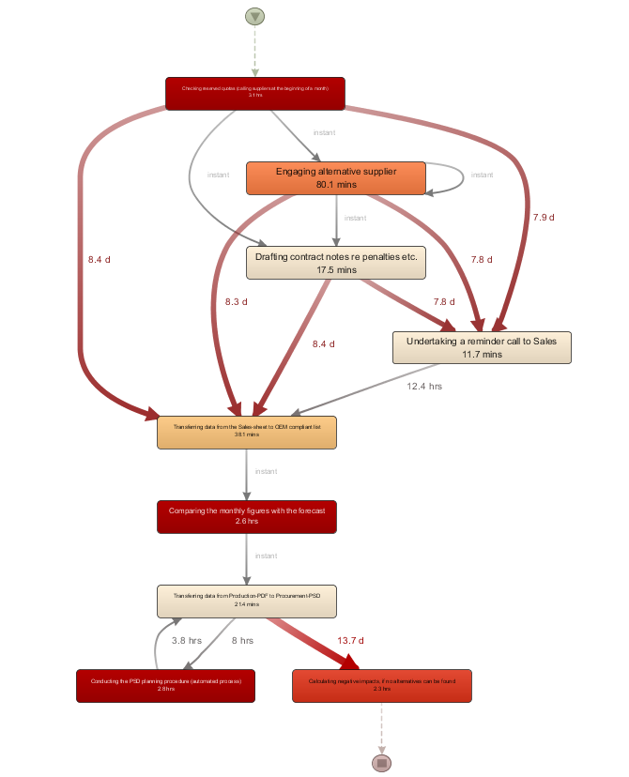
Mean duration of tasks over the whole period (2010-2014):
Findings:
Waiting times
Time consuming tasks

Slide 25
CONTENT
REQUIREMENT ANALYSIS
ANALYSIS OF DATA SOURCES
CONCEPTUAL DESIGN
PROOF-OF-CONCEPT
PROCESS INTELLIGENCE
BUSINESS RECOMMENDATIONS

Slide 26

BUSINESS RECOMMENDATION
Adjust OLTP:
Create integrity and business rules (constraints)
Improve database design
Use anlytical insights:
Track your material price
Use process insights:
Improve pain-points (e. g. bottlenecks)

Slide 27
Thank you for your attention!

Slide 28
BACK UP

